Slide 1
Modeling Hit Potential of Songs: A Data-Driven Approach
BUAN 6356.501 - Business Analytics With R
Group C
Priyadarshan Parida
Sunayana Jana
Soniya Rajappan
Arun Anantharam Bagade
Bui Toan Thu Le
Hrishi Anand Basutkar

Slide 2






Project Overview & Objective
Objective
Predict hit potential of songs using machine learning models and inform actions during pre- and post-production stages.
Why This Matters?
Millions of songs, few hits. Data-driven insights can inform marketing spend & timing.
Data Comprises...
Billboard chart trends
Audio features
Spotify metadata
Engagement metrics
Raw Dataset Shape: 29K+ songs and 26 features.
Sneak Peek: Decision Tree 82.7% | Logistic Regression 83.3%.
Problem Statement
Can we predict hit potential of a song on the basis of audio features, streaming platform metadata, and social engagement?
Scope
Supervised machine learning – classification models, Feature importance, Model assessment, & Insights.
Music discovery overload: 100K+ songs released daily;
< 0.01% make Billboard Top 10
From intuition to intelligence: AI and analytics guide A&R and marketing decisions
Target Variable
Focal dependent variable: binary variable ‘HIT’ indicating whether the song was a billboard hit.
1: was a top 10 hit | 0: Otherwise
Key Performance Indicator
Low Type I Error (<10%) is critical to achieve because false positives lead to costly marketing spend on songs unlikely to succeed.
Finance decisions: Early hit prediction optimizes promotion, reduces spend, guides investments, boost ROI

Slide 3
Approach & Methodology
Data Exploration & Pre-processing
Exploratory Data Analysis
Feature Engineering
Feature Selection
Predictive Modelling
Insights
Data inspection, clean up, merging, duplicate removal, missing-value handling
Summary statistics, data distribution, outlier treatment, pattern and trend identification.
Feature extraction, log transformation of skewed distributions, feature encoding.
Handle irrelevant and high cardinality features, target leakage, Decision Tree feature importance based feature selection.
Decision Tree and Logistics Regression classifier training, fine-tuning, and model assessment.
Interpretation of results, summarize insights and suggest actions.

Slide 4
Data Exploration – Summary Stats and Variable Profiling
Billboard Chart Trends
Peak Position (PEAK_POSITION)
Candidate for target leakage assessment in later steps.
Variable | Definition | Mean | Std Dev | Min | Max
HIT | Billboard hit indicator (1 = hit) | - | - | - | -
PEAK_POSITION | Peak position of a song in the chart | 46.64 | 30.55 | 1 | 100
WEEKS_ON_CHART | Total weeks on billboard chart | 11.18 | 8.3 | 1 | 87
DEBUT_RANK | Debut position | 80.43 | 19.04 | 1 | 100
FIRST_WEEK | Char entry date | - | - | 1969-01-04 | 2068-12-28
1
Entry Date (FIRST_WEEK)
Erroneous years. Data quality issue: date requires correction or removal.
2
Spotify Metadata
High Cardinality in Song and Artist Details
SONG, ARTIST, SONG_DISPLAY, ARTIST_DISPLAY demonstrate high cardinality.
Variable | Definition | Mean | Std Dev | Min | Max | Count | Unique
SONG | Song title | - | - | - | - | 29,410 | 23,552
ARTIST | Artist name | - | - | - | - | 29,410 | 9,990
SONG_DISPLAY | Display name for a song | - | - | - | - | 29,410 | 24,334
ARTIST_DISPLAY | Display name of an artist | - | - | - | - | 29,410 | 10,054
PLAYLIST_GENRE | Spotify playlist genre | - | - | - | - | 3,469 | 6
PLAYLIST_SUBGENRE | Spotify playlist subgenre | - | - | - | - | 3,469 | 23
SPOTIFY_POPULARITY | Spotify popularity (0 –100) | 40.46 | 20.42 | 0 | 100 | - | -
3
Sparsity in PLAYLIST_GENRE PLAYLIST_SUBGENRE
High number of missing values. Could still have predictive power based on streaming platform presence → FE.
4

Slide 5
Data Exploration – Summary Stats and Variable Profiling
Audio Features & Track Metadata
Audio Features Ranging 0-1
Most audio features are normalized continuous values ranging from 0 to 1.
Variable | Definition | Mean | Std Dev | Min | Max | Count | Unique
DANCEABILITY | Rhythm suitability (0–1) | 0.60 | 0.14 | 0 | 0.99 | - | -
ENERGY | Track intensity (0–1) | 0.62 | 0.28 | 0.0006 | 0.997 | - | -
VALENCE | Musical positivity | 0.60 | 0.22 | 0 | 0.99 | - | -
ACOUSTICNESS | Acoustic probability | 0.28 | 0.26 | 0 | 0.99 | - | -
SPEECHINESS | Spoken-word content | 0.07 | 0.08 | 0 | 0.95 | - | -
INSTRUMENTALNESS | Instrumental probability | 0.03 | 0.12 | 0 | 0.98 | - | -
LIVENESS | Live-recording indicator | 0.18 | 0.15 | 0.0097 | 0.999 | - | -
LOUDNESS | Loudness (dB) | -8.59 | 3.28 | -28.03 | 2.29 | - | -
TEMPO | Beats per minute (BPM) | 120.05 | 25.52 | 0 | 241.01 | - | -
DURATION | Track length (ms) | 219924 | 61858.9 | 29688 | 3079157 | - | -
GENRE | Song genre | - | - | - | - | 29410 | 652
1
Loudness and Tempo
Loudness and Tempo are reported in real-world units (dB, BPM).
2
Duration & Mentions → Unusual Min and Max
Both variables exhibit extreme min and max values. Likely candidate for outlier treatment or log transformation.
3
Engagement Metrics
Genre → Requires Consolidation
Genre exhibits high cardinality and hence requires consolidation.
Variable | Definition | Mean | Std Dev | Min | Max
SENTIMENT_POLARITY | Polarity of online text | 0.14 | 0.23 | -0.92 | 0.94
SENTIMENT_SUBJECTIVITY | Subjectivity of online text | 0.25 | 0.095 | 0 | 0.796
MENTIONS | Count of online mentions | 16416.51 | 29719.84 | 0 | 236,713
4

Slide 6
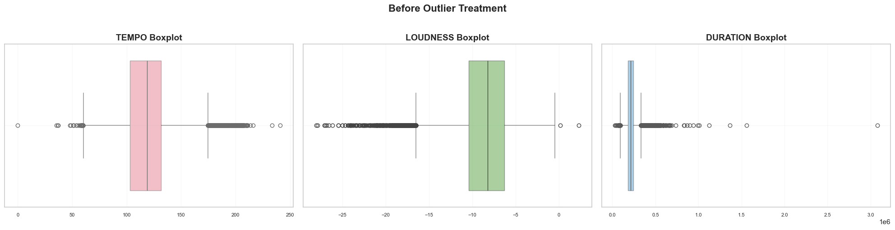
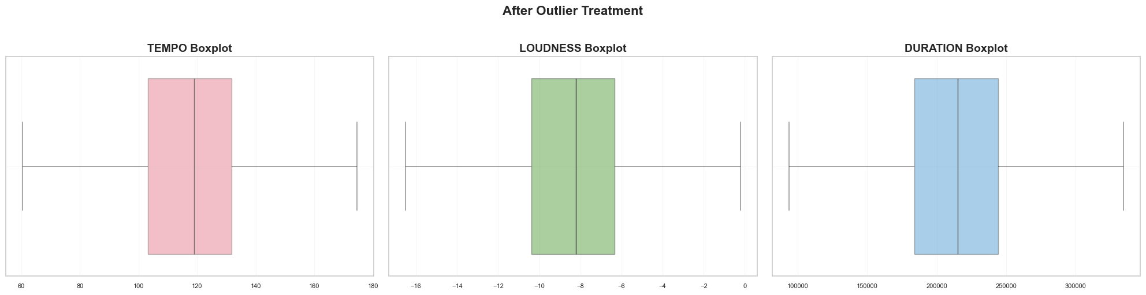
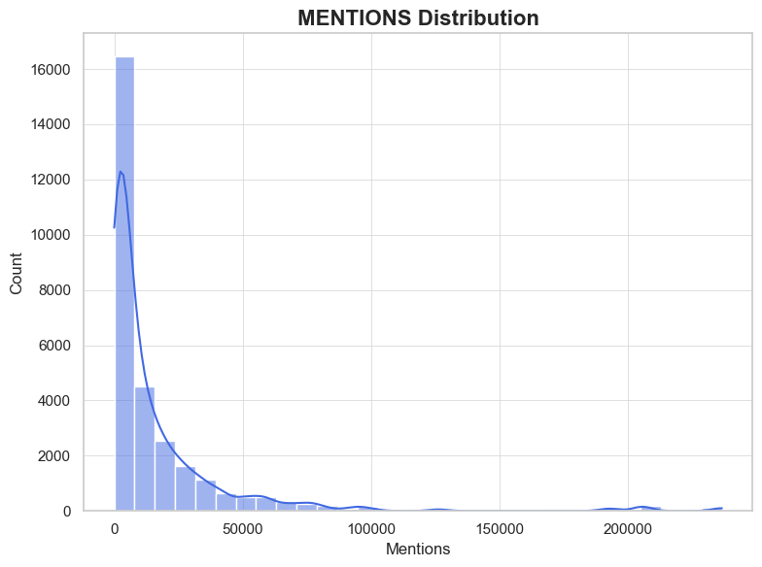
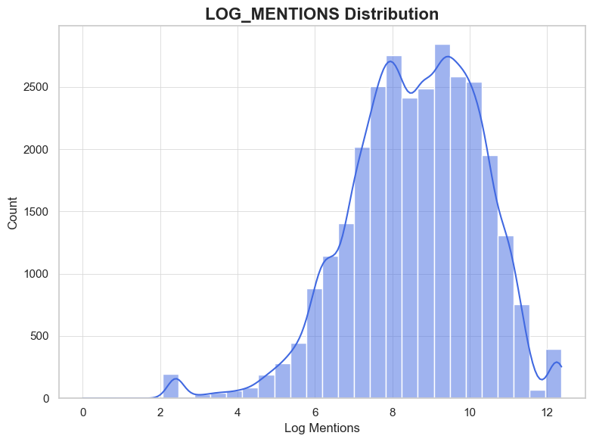
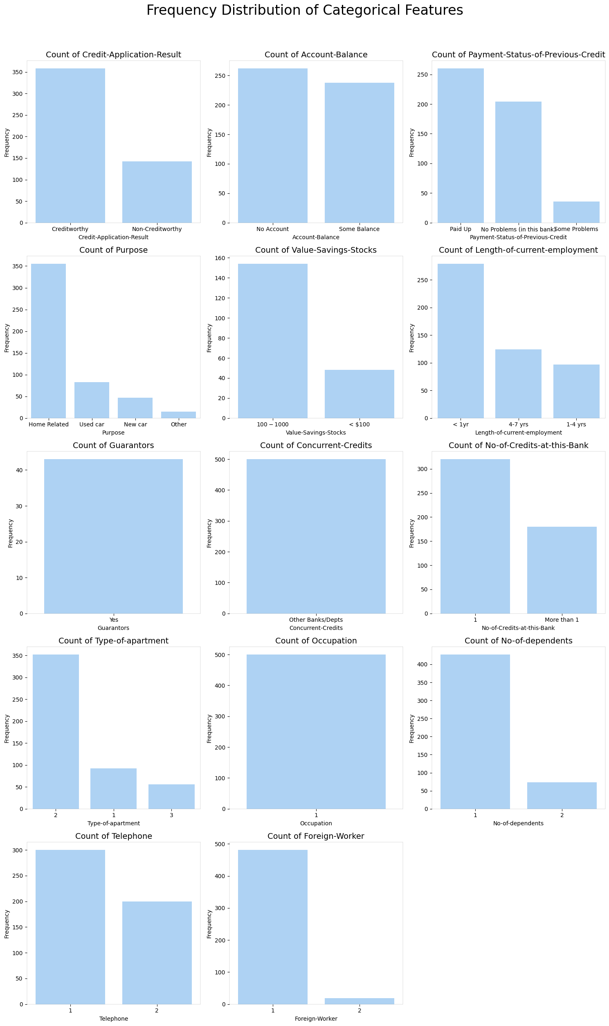
Data Pre-processing – Outlier and Skewness Treatment
Outlier Treatment – Tempo, Loudness, Duration
Extreme outliers identified using boxplots. IQR-based winsorization applied to reduce distortion and stabilize model behavior.
1
Log Transformation for Right-Skewness – Mentions
Raw mention counts were heavily right-skewed. Applied log transformation to normalize the distribution for modeling.
2

Slide 7
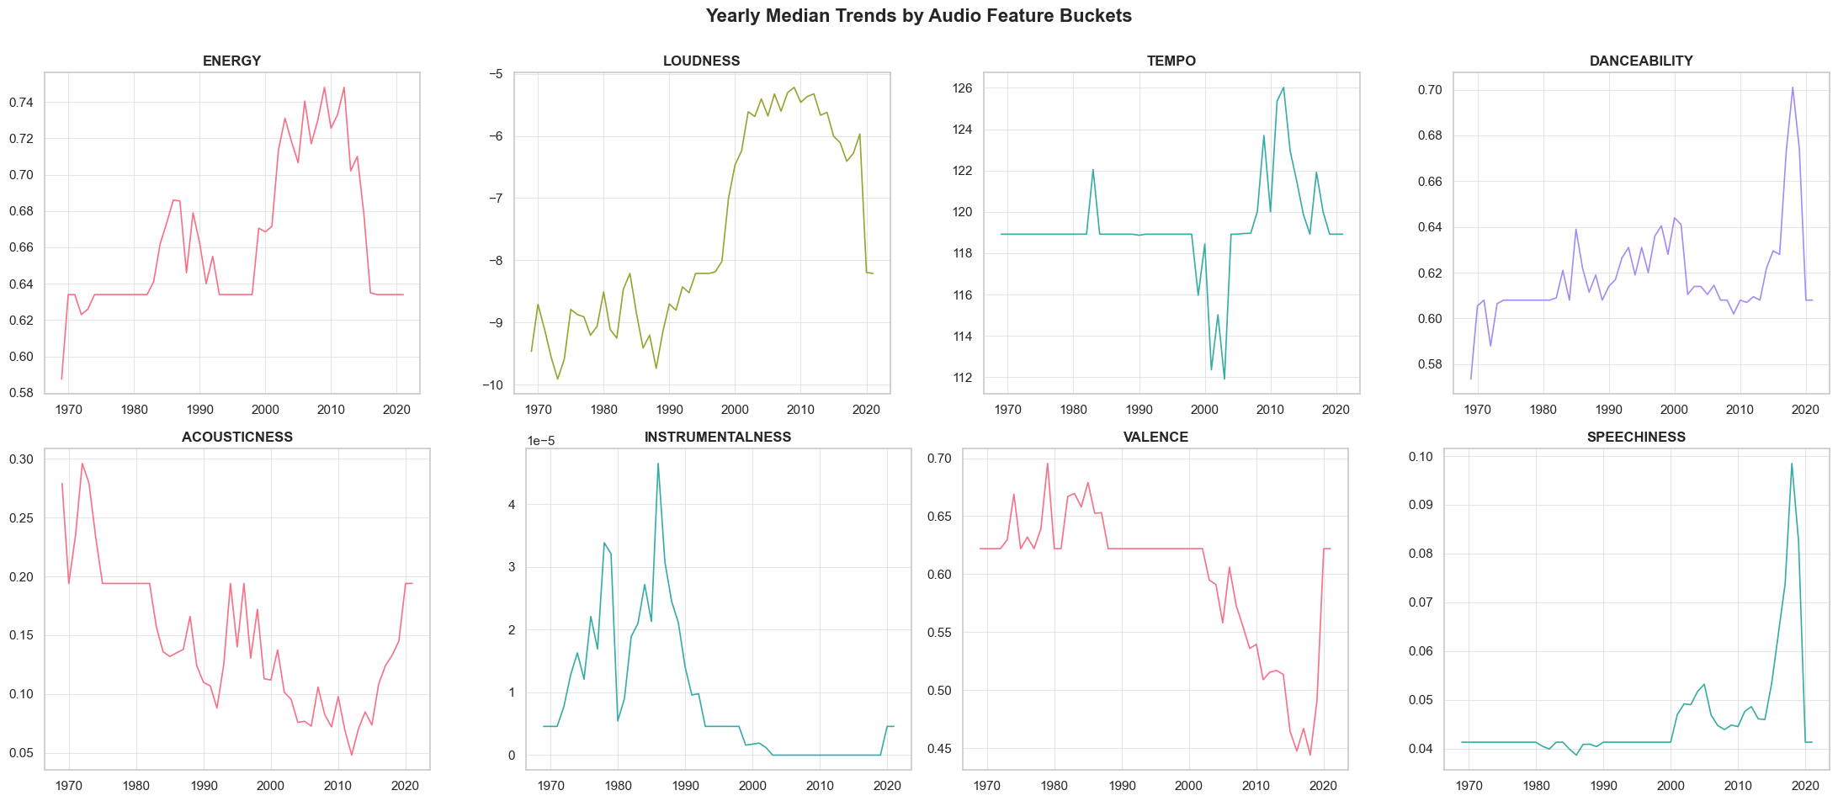
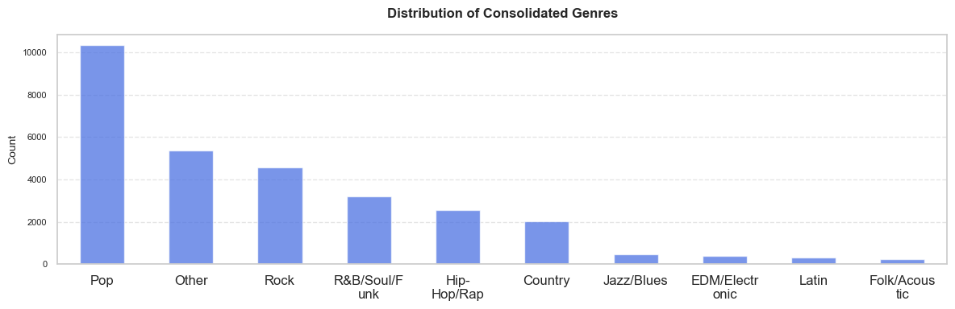
EDA – Audio & Genre Trends Over the Years
High Energy Trended in the Last Decades
The initial rising trend in energy, loudness, and tempo reflected modern production trends of high energy digitally produced songs.
1
Recent Tapering Off
Attributed to a renewed demand for more organic audio. This aligns with the recent rise in acousticness and instrumentalness after long-term declining trend.
2
Are Hip-Hop/Rap Going Mainstream?
Combined movement in speechiness + danceability + lower valence signals growing production of rap/hip-hop in mainstream charts.
3
Pop Dominates Production Landscape
Pop remains the dominant genre, followed by Rock, reflecting long-standing mainstream preferences.
4

Slide 8
Feature Engineering & Feature Selection
Engineered Features
LOG_MENTIONS to address skewness • HAS_PLAYLIST to model Spotify presence • GENRE_CLEAN + one-hot encoded genre dummies
HAS_PLAYLIST | GENRE dummies
From Spotify playlist genre | Raw genre → Clean genre → Dummies
1
Data Columns | Treatment
SONG, ARTIST, DISPLAY fields | Dropped identifiers
Dropped Identifiers Columns
Dropped identifier columns – textual data, no explanatory power.
2
Dropped Columns after Feature Extraction
Dropped GENRE (high cardinality) after extracting consolidated GENRE_CLEAN.
Data Columns | Treatment
GENRE | Dropped after consolidation
3
Dropped Date Field after EDA
Dropped FIRST_WEEK due to data quality issues in significant proportion of observations (> 25%).
Data Columns | Treatment
FIRST_WEEK | Dropped due to data quality issues
4
Target Leakage (** Iterative DT importance checks)
PEAK_POSITION and WEEKS_ON_CHART removed as they leak chart outcome.
Data Columns | Treatment
PEAK_POSITION, WEEKS_ON_CHART | Dropped to prevent target leakage
5
Notes:
Coming to feature engineering, as explained in one of our previous slides, we applied log-transformation to social mentions. Also, extracted a dummy indicating streaming platform presence from Spotify metadata fields. We one-hot encoded the genere categories after consolidation. The respective raw data were then omitted from subsequent steps.
Under the initial feature selection steps:
We dropped high cardinality columns like artists, song, display fields as they inflated the dimensionlity with addition of little to no predictive power.
The FIRST_WEEK date field was omitted due to significant data quality issues.
Removed target leakage variables like PEAK_POSITION and WEEKS_ON_CHART which was determined based on correaltion analysis and GINI impurity based feature importance.

Slide 9
Decision Tree - Setup, Approach, and Performance
Model Setup
Hyperparameters
Tuning Rationale
Removed leakage variables (Peak Position, Weeks on Chart).
Retained audio features, Spotify metadata, genre dummies, and online engagement.
Used model-based feature importance to reduce inputs to the strongest predictors. Ensures interpretability and avoids noise from unused variables
maxdepth=6
Prevent overly deep, overfitted trees
minbucket=10
Avoid tiny, unstable leaf nodes
minsplit=20
Prevent micro-grained splits
classweight={0:1, 1:2}
Increase sensitivity to minority class
Model Performance and Why This Balance Is Acceptable?
cp = 0.001
Remove weak branches for stability
Training Accuracy: 83.4% Testing Accuracy: 82.73%
Provides a stable trade-off between identifying hits and avoiding high false positives.
Balance is acceptable given the primary goal of producing a highly interpretable model. Also,
Avoids aggressive overfitting seen with deeper trees. Avoids excessive false positives, Type I Error Rate: 9.94%
Final model is intentionally compact (depth = 6, 19 leaves) for interpretability
TNR (Specificity): 0.9006
TRUE NEGATIVE
6596
FPR (Type I Error): 0.0994 – 9.94%
FALSE POSITIVE
728
Future Scope
FNR (Type II Error): 0.5310
FALSE NEGATIVE
796
TPR (Recall/Sensitivity): 0.4690
TRUE POSITIVE
703
Severe class imbalance limits model performance with regard to HIT precision.
Feature scope for for improving predictive power through advanced techniques to handle class imbalance – SMOTE.
Notes:
We built a decision tree designed to balance interpretability and performance.
Used decision tree feature importance to retain the strongest predictors.
Key tuning choices included setting max depth to 6, minimum bucket size to 10, min split to 20 and an optimum complexity parameter. Class weights were adjusted to increase sensitivity to the minority class.
The final tree had 19 leaves, and it achieved:
82.73% Accuracy with under 10% Type I Error rate. Given our objective, achieving a low Type I error rate was critical. We ensured thre is no overfitting, as confirmed through comparable training and testing accuracy.
Next – And here's a pictorial representation of our decision tree – it is neither overly complex nor too simple. This is a delibereate choice to strike the overfitting-underfitting balance.

Slide 10
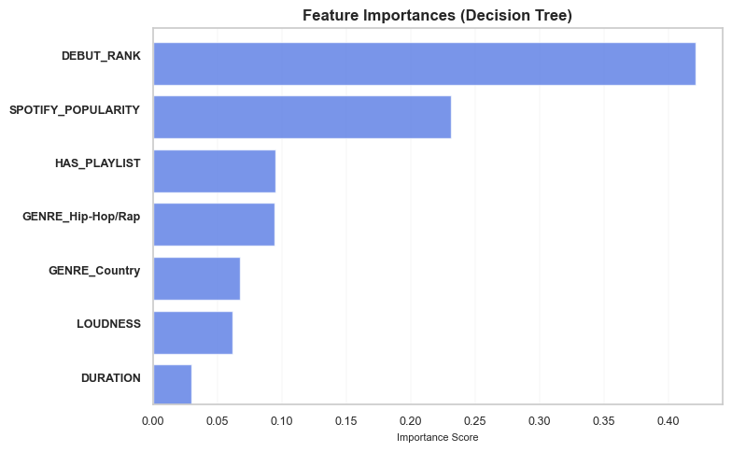
Decision Tree – Results, Interpretation, and Insights
Debut Rank is the Strongest Predictor
This can be a strong early signal for timing the marketing spend. Streaming platform listening will hold the key.
1
Streaming Platforms Play a Crucial Role
Streaming platforms provide the required exposure and accelerate success as evident from the importance of Spotify Popularity and Playlist Presence.
2
Hip-Hop/Rap and Country Genres
Genre influences split pathways, particularly Hip-Hop/Rap and Country. Directionality of the influence is unknown, though.
3
The tree’s first split is on Debut Rank, indicating early chart momentum drives overall outcomes.
Subsequent splits rely on Spotify Popularity and Playlist Presence, emphasizing early exposure and listener traction.
Leaf nodes reveal clear patterns: songs with strong early metrics cluster into high hit-probability paths, while lower-ranked tracks fall into non-hit branches.
Audio feature – Loudness
Loudness also featured amongst the important predictors but the directionality of its influence is explored in upcoming slides.
4
Notes:
On this slide we have presented the GINI based feature importance and their economic interpretations:
Debut Rank resulted in the first and strongest split and is critical to a song's success.
Spotify Popularity which is indicative of user engagement on streaming platform was a consistent second-level split, reinforcing the influence of streaming traction. Presence on Spotify Playlist was next, indicating that streaming platform exposure is a strong predictor.
Audio loudness and genres such as Hip-Hop and Country featured amongst the important predictors. We explore the directionality of their influence in upcoming slides.

Slide 11
Logistic Regression - Setup, Approach, and Performance
Model Setup
Hyperparameters
Tuning Rationale
Removed leakage variables (Peak Position, Weeks on Chart).
Retained audio features, Spotify metadata, genre dummies, and playlist presence.
Standardized all numeric predictors as the model is vulnerable to difference in scales.
max_iter=300
Ensured convergence of the MLE; model stabilized at iteration 35.
solver="lbfgs"
Robust optimizer for medium–large feature spaces.
Model Performance and Why This Balance Is Acceptable?
Evaluated thresholds from 0.01 to 0.59 and chose 0.35 as the final operating point as it offered the best trade-off between precision (0.51) and recall (0.418).
Avoids excessive false positives, Type I Error Rate: 8.22%
Training Accuracy: 84% Testing Accuracy: 83.29%
Performance is strong despite the severe class imbalance (17% hits), with logistic regression producing a stable linear decision boundary.
Recall is intentionally moderated to reduce excessive false alarms, producing a cleaner, more conservative hit-prediction signal.
ROC-AUC = 0.806, indicating the model captures meaningful probability ranking of HIT vs NON-HIT
TNR (Specificity): 0.9178
TRUE NEGATIVE
6722
FPR (Type I Error): 0.0822 – 8.22%
FALSE POSITIVE
602
Future Scope
FNR (Type II Error): 0.5817
FALSE NEGATIVE
872
TPR (Recall/Sensitivity): 0.4183
TRUE POSITIVE
627
Consider regularized LR (L1/L2) to refine coefficient stability and address multicollinearity in genre dummies.
Notes:
For logistic regression, we standardized all numeric predictors as the model is sensitive to the scale of the input features. The variables known to leak target were removed as discussed earlier.
We evaluated a grid of thresholds which is the probability cut-off for assigning a positive class. And determined that 0.35 provided the best balance between recall and false positives.
Model results showed 83.29% Accuracy, and the Type I Error remained well below the KPI level of 10%. We achieved consistent training and testing accuracy which indicates that the model generalizes well to unseen data.

Slide 12
Logistic Regression – Results, Interpretation, and Insights
Statistically Significant Predictors | Effect on HIT
Debut Rank | Negative ~47% ↓
Spotify Popularity, Playlist Presence | Strong positive ~2x and 3x ↑
Country and Hip-Hop genres combined with Speechiness | Negative ~80%, 62%, 15% ↓
Pop and EDM/Electronic | Positive ~30% and 68% ↑
Loudness | Negative ~80% ↓
Valence and Acousticness | Positive ~60% and 26% ↑
Debut Rank Is the Most Influential Predictor
Debut Rank carries the strongest negative coefficient, meaning early chart trends signal HIT potential and Record Labels should strategize marketing effort based on such indication.
1
Streaming Platform Signals Drive Hit Probability
Spotify Popularity and Playlist Presence show large, positive, and highly significant coefficients. Hence, investment in this direction can promise good ROI.
2
Hip-Hop/Rap and Country Genres
Hip-Hop/Rap (negative) and Country (strong negative) significantly reduce hit likelihood, contrary to Pop and EDM/Electronic which continue to be overall mainstream preference.
3
Post-production: Early chart metrics along with streaming platform exposure and popularity are strong indicators of post-release success signal. They should inform marketing spend and strategy.
Pre-production: Songs with positive emotional tone (Valence) and richer acoustic profiles tend to perform better. Despite the recent production momentum in Hip-Hop/Rap, they are much less likely to produce hits, while Pop and EDM/Electronic remain reliable mainstream choices.
Audio Characteristics – Loudness, Valence, Acousticness
Higher Loudness decreases hit probability, suggesting overly loud mixes may underperform. Valence and Acousticness increase hit likelihood, reflecting listener preference for tracks with balance, warmth, or emotional positivity.
4
Notes:
On this slide we present the model summary and its interpretaion. While the results are consistent with what we saw in Decision Tree, we have information about directionality now.
Next – Here are the estimated coeffcients on the predictors and their statistical significance. Back to the original slide, we simplified this to look at the top features in the order of statistical and economic significance.
Debut Rank has the strongest negative coefficient, meaning better rank improves the odds of a hit. Like we stated before, this can be a strong indicator for focussing marketing effort post-production.
Spotify metadata like Popularity and Playlist Presence have strong, positive, and highly significant effects which means songs with early streaming traction have substantially higher odds of becoming hits. Increased investment on Streming Platform partnerships offer excellent ROI.
Genre effects show Hip-Hop and Country decrease hit probability indicating polarity in choice, consistent with what we also saw in the Decision Tree results but the direction becomes clearer now. Pop and EDM align with mainstream success.
The model revealed several pre-production indicators of hit potential. Higher Valence and Acousticness are associated with a greater likelihood of success, while excessive Loudness lowers it. This suggests that listeners tend to prefer tracks with a warmer, more organic sound and a balanced loudness profile.

Slide 13



Reflections
01
03
02
Top Interesting Findings
Business Implications
Limitations & Opportunities
Extreme Loudness Hurts Hit Probability: Contrary to what might seems intuitive.
Hip-Hop/Rap Momentum ≠ Hit Probability: The production momentum has not quite translated into mainstream acceptance.
Social Buzz Matters Less: Indicates that music attributes and early chart signals outweigh hype.
Pre-production: Favor positive-emotion and balanced/organic mixes.
Post-production: Leverage early streaming traction (Popularity + Playlist presence) as actionable hit signals.
Strategy: Partner with streaming platforms – early exposure drives hits.
Hit class imbalance limits recall: Future models could improve via sampling/SMOTE or more advanced methods.
Additional data: Radio plays, TikTok metrics, lyrical embeddings could enhance prediction accuracy.
Advanced Models: Regularized models or ensemble methods (RF, XGBoost) could yield stronger performance.
Notes:
To wrap up, here are a few key reflections from the analysis.
We will start by examining some of the interesting findings that might seem less intuitive.
The model’s finding that loudness reduces hit probability doesn’t mean loud songs can’t become hits—they certainly can. It explains a general listener preference for tracks with moderate, balanced amplitude.
Similarly lower hit potential for Hip/Hop might seem to contradct the higher production trend in this genre. But it just means that the recent production momentum has not quite translated into a mainstream trend yet.
Third, we address the lower significance of social buzz. This suggests that social buzz tends to follow a song’s success rather being the major driver for it.
Next, we summarize the business actions implied by the findings we discussed.
In pre-production, the results suggest prioritizing positive-emotion tracks and more balanced, organic mixes.
In post-production, marketing should be timed and scaled according to early debut trends, partnerships with streaming platforms for exposure can widen the reach.
Lastly, we acknowledge the model’s limitations stemming from class imbalance and outline future directions, including exploring advanced ensemble methods and expanding the dataset to capture a broader range of variation.
With that we conclude the presentation. Thank you.

Slide 14
Thank you!

Slide 15
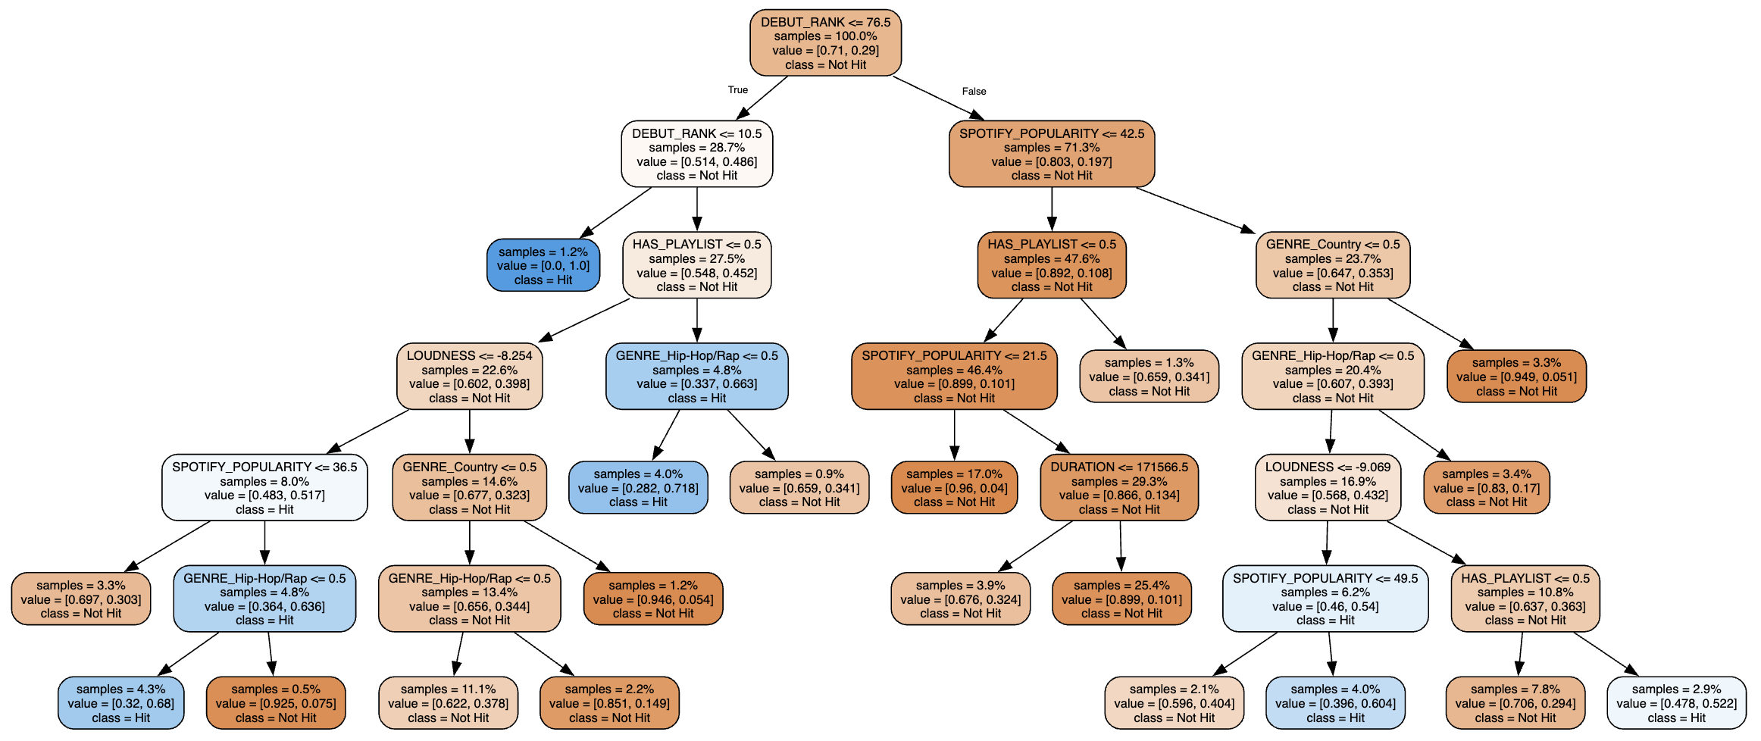
Decision Tree

Slide 16
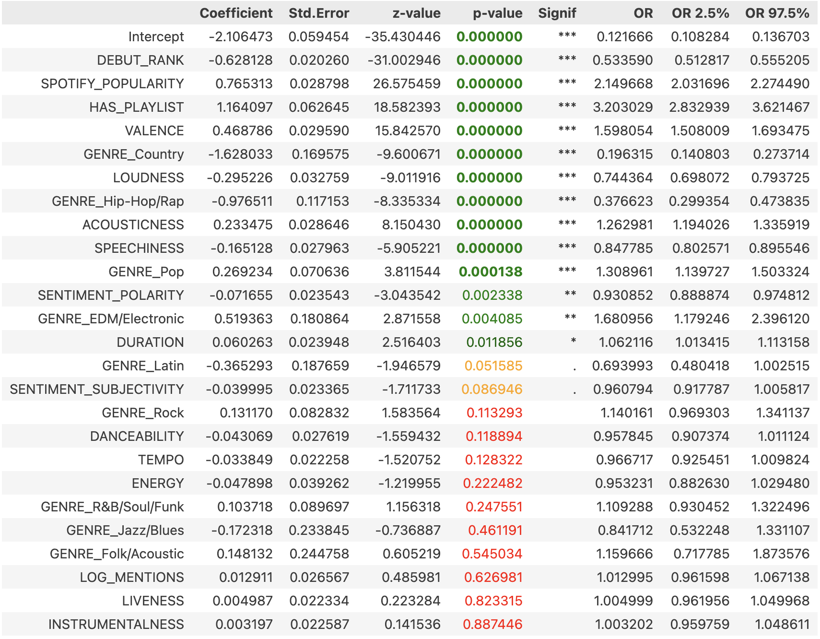
Logistic Regression Statistical Significance & Odds Ratio

